Slide 1
Security Controls in Shared Source Code Repositories
2/27/2022 Oksana Kustova

Slide 2
Shared Source Code Repositories
A source-code repository is an archive with the code as well as the hosting facility for these software archives, where you can also have the project’s technical documentation, web pages, snippets, patches, etc. which can be accessed publicly (open-source) or privately.

Slide 3
Shared Source Code Repositories
What can a source code repository do?
Keeps your code safe
Offers version control option to make sure all changes that were done to your code are tracked, and you know who did something to your code. You can also revert back to the previous version of the code before “Everything went bad.”
Simplifies the process of unifying changes from developers’ collaboration
Provides and promotes teamwork principles since several developers can work together on the same projects, modules, and even code lines
Prepares your code for release to production
Keep the statistics and analytics of the changes in the code

Slide 4
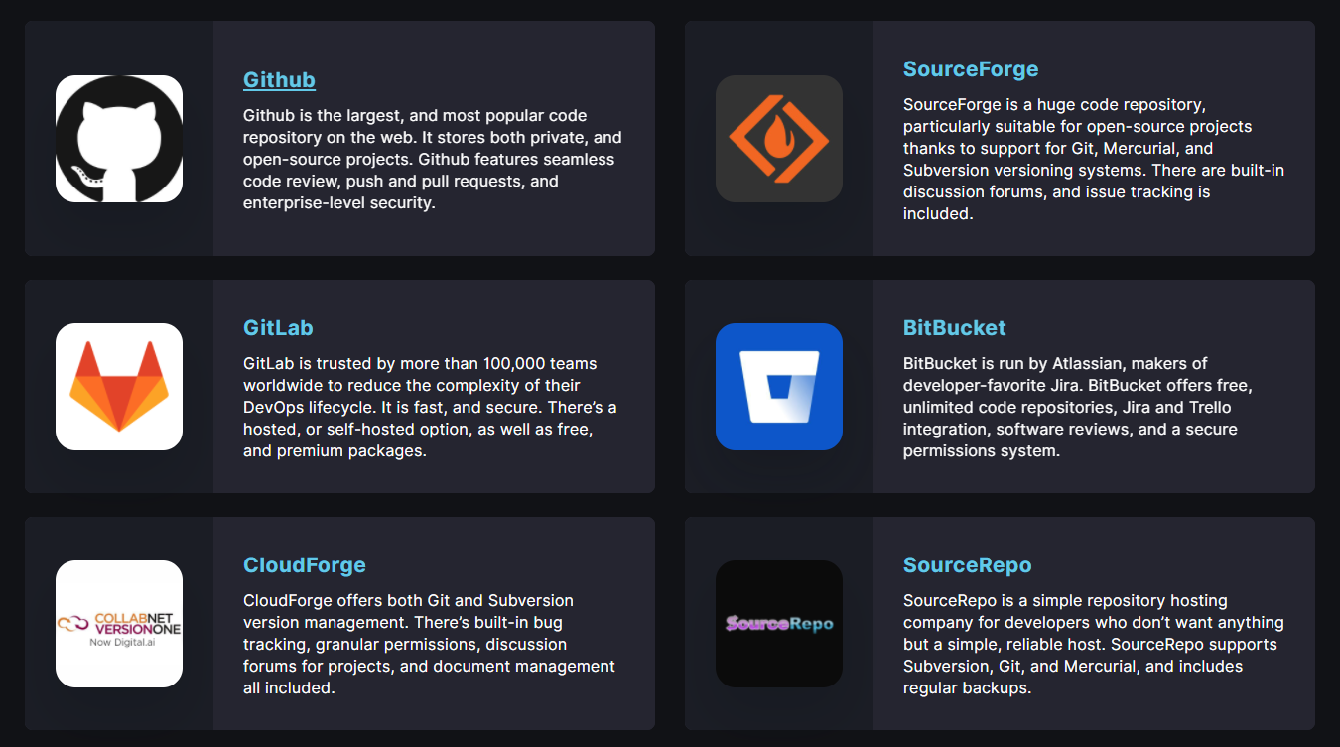
Code Repositories

Slide 5
Shared Source Code Repositories
What is the purpose of a code repository
Version control for your project is critical.
Code repositories are great community builders.
Code repositories are great digital portfolios or resumes.

Slide 6
Protect your code repository
Your code is only as secure as the systems used to create it. As the central point at which your code is stored and managed, it's crucial that the repository is sufficiently secure.
Loss or compromise of access credentials, or breach of the underlying service, may allow attackers to modify your code base without your knowledge or permission.
Version control, peer review and built-in auditing are some of the advantages which come with using a code repository. If proper attention is paid to security measures, the benefits of using a repository far outweigh the risks.

Slide 7
Protect your code repository
Choose a repository you trust.
Consider the exposure of your repository. Technically enforce a model of least privilege for who can make changes to your code repository. Make sure all activity is attributable.
Protect access credentials. User access to repositories is often authenticated using credentials, such as passwords or private keys.
Separate secret credentials from source code. Logically separating secret credentials from source code and having a carefully defined injection process will help prevent them from getting leaked.

Slide 8
Protect your code repository
Access to the repository should be revoked swiftly when no longer required, or in the event of compromise.
Include open code in your risk model. Some of your code may be more appropriately stored in a private repository. For example, code used to detect fraud attacks would be of particular benefit to an adversary wishing to avoid such measures.
Review all code changes. Certain code repositories or branches will hold the source code from which production deployments are made. Ensure that all code merged into this master version has gone through a review process to help prevent unintended or malicious code being included.

Slide 9
Protect your code repository
External code changes may be malicious. When coding in the open, an attacker may attempt to change or influence your code. Carefully review any change or pull requests to understand security implications, noting that attacks could be subtle or disguised. Take extra care if any of this code is automatically run in your build and test infrastructure, as it could be malicious.
If using a publicly accessible repository, take care of your identity.
Ensure your code is backed up.

Slide 10
References
Best code repositories for designers in 2020. Webdesign Toolbox. (2020, January 27). Retrieved February 27, 2022, from https://webdesigntoolbox.com/code-repositories
by: HUSPI, W. (2022, February 15). How to choose code repository for your project [prices updated]. HUSPI. Retrieved February 27, 2022, from https://huspi.com/blog-open/software-code-repositories/
Protect your code repository. NCSC. (n.d.). Retrieved February 27, 2022, from https://www.ncsc.gov.uk/collection/developers-collection/principles/protect-your-code-repository
What you need to know about code repository threats. Cyberint. (2021, December 26). Retrieved February 27, 2022, from https://cyberint.com/blog/threat-intelligence/what-you-need-to-know-about-code-repository-threats/

